Slide 1
Lecture 5: Introduction to SQL Part 1
Notes:
1

Slide 2
History
IBM Sequel language developed as part of System R project at the IBM San Jose Research Laboratory
Renamed Structured Query Language (SQL)
ANSI and ISO standard SQL:
SQL-86, SQL-89, SQL-92
SQL:1999, SQL:2003, SQL:2008
Commercial systems offer most, if not all, SQL-92 features, plus varying feature sets from later standards and special proprietary features.
Not all examples here may work on your particular system.
Notes:
2

Slide 3
Structured Query Language (SQL)
SQL is a powerful language for extracting information and managing data in a database
SQL has two parts:
Data Definition Language (DDL):
CREATE and DROP tables, indexes, and views
GRANT and REVOKE access rights to database objects
Data Manipulation Language (DML):
INSERT, UPDATE, and DELETE statements
SELECT statement to query the database for useful information
How many students are registered in course ICS311?
How many products in the inventory are priced more than $100?
SQL can NOT be used to:
Create menus, reports, pop-ups or other utilities
3

Slide 4
Data Definition Language
The SQL data-definition language (DDL) allows the specification of information about relations, including:
The schema for each relation.
The domain of values associated with each attribute.
Integrity constraints
Other information such as
The set of indices to be maintained for each relation.
Security and authorization information for each relation.
The physical storage structure of each relation on disk.
Notes:
4

Slide 5
Data Definition Language (DDL)
Creating the database:
Creating Tables
Defining Constraints
5

Slide 6
DDL: Creating the Database
SQL is used to:
Specify the database structure (or Database Schema)
Specify the schema for each table that will hold the end users data
DBMS:
Automatically creates the data dictionary
Creates the physical files that will hold the database
6

Slide 7
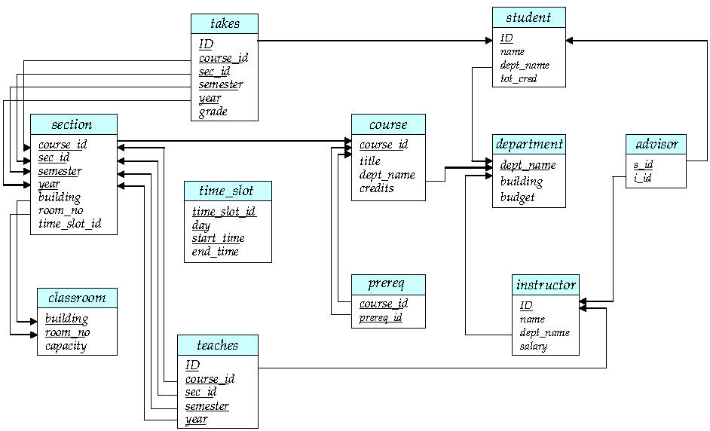
Schema Diagram for University Database

Slide 8
MySQL requires you to work with a database
Open (or create if it does not exist) a database
Create database university;
Once it is created, you can check it:
use university;
To see a list of current databases:
show databases;
Deleting a database (WARNING: you will lose all tables and records associated with it):
drop database university;

Slide 9
DDL: Creating a table
create table tablename (
column 1 data type [constraint],
column 2 data type [constraint],
primary key (column x),
foreign key (column y) references tablename (column z),
constraint constraint);

Slide 10
Domain/Data Types in SQL
char(n). Fixed length character string, with user-specified length n.
varchar(n). Variable length character strings, with user-specified maximum length n.
int. Integer (a finite subset of the integers that is machine-dependent).
smallint. Small integer (a machine-dependent subset of the integer domain type).
numeric(p,d). Fixed point number, with user-specified precision of p digits, with d digits to the right of decimal point.
real, double precision. Floating point and double-precision floating point numbers, with machine-dependent precision.
float(n). Floating point number, with user-specified precision of at least n digits.
date. A variable to hold date values. Format for date YYYY-MM-DD
Notes:
10

Slide 11
DDL: Integrity Constraints
Entity integrity:
Primary key (ID)
Referential integrity:
Foreign key (dept_name) references department (dept_name)
11

Slide 12
DDL: Data Constraints
CONSTRAINT is used to define rules to allow or restrict what values can be stored in columns. The purpose of inducing constraints is to enforce the integrity of a database.
CONSTRAINTS are used to limit the type of data that can be inserted into a table.
can be classified into two types - column level and table level.
The column level constraints can apply only to one column where as table level
constraints are applied to the entire table.
is declared at the time of creating a table.
CONSTRAINTs are :
NOT NULL
UNIQUE
PRIMARY KEY
FOREIGN KEY
CHECK
DEFAULT

Slide 13
DDL: Data Constraints
CONSTRAINT | DESCRIPTION
NOT NULL | NOT NULL constraint allows to specify that a column can not contain any NULL value. MySQL NOT NULL can be used to CREATE and ALTER a table.
UNIQUE | The UNIQUE constraint does not allow to insert a duplicate value in a column. The UNIQUE constraint maintains the uniqueness of a column in a table. More than one UNIQUE column can be used in a table.
PRIMARY KEY | A PRIMARY KEY constraint for a table enforces the table to accept unique data for a specific column and this constraint creates a unique index for accessing the table faster.
FOREIGN KEY | A FOREIGN KEY creates a link between two tables by one specific column of both tables. The specified column in one table must be a PRIMARY KEY and referred by the column of another table known as FOREIGN KEY.
CHECK | A CHECK constraint controls the values in the associated column. The CHECK constraint determines whether the value is valid or not from a logical expression.
DEFAULT | Each column must contain a value ( including a NULL). While inserting data into a table, if no value is supplied to a column, then the column gets the value set as DEFAULT.

Slide 14
DDL: Create Table
create table department ( dept_name varchar(20), building varchar(20), budget numeric(12,2), primary key (dept_name));
create table instructor (
ID varchar(5),
name varchar(20),
dept_name varchar(20),
salary numeric(8,2),
primary key (ID),
foreign key (dept_name) references department(dept_name));

Slide 15
Describe
In order to view table schema (column names and their data types)
describe instructor;
OR
desc instructor;
15

Slide 16
CONSTRAINTS
Syntax :
CREATE TABLE [table name]
([column name] [data type]([size]) [column constraint]….
[table constraint] ([[column name]……])……);
create table instructor (id varchar(5),
name varchar(20) NOT NULL,
dept_name varchar(20) DEFAULT ‘Biology’,
salary numeric(8,2) CHECK (salary > 29000),
primary key (ID),
foreign key (dept_name) references department (dept_name)
);
Note: Review University DDL script for more examples

Slide 17
Things to Note
The department table must be created first:
instructor table contains a foreign key that references department
primary key declaration on an attribute automatically ensures NOT NULL and UNIQUE
Reserved words:
Words that are known by the system as SQL words:
SELECT, INTEGER, CONSTRAINT
These words cannot be used as column or table names

Slide 18
Class Exercise 1
Create table Student
Create table Course
Create table Takes

Slide 19
Schema Diagram for University Database

Slide 20
Class Exercise 1
Create table Student
create table student ( ID varchar(5), name varchar(20), dept_name varchar(20), tot_cred numeric(3,0),
primary key (ID),
foreign key (dept_name) references department (dept_name));

Slide 21
Class Exercise 1
2. Create table Course
create table course ( course_id varchar(8) primary key, title varchar(50), dept_name varchar(20), credits numeric(2,0),
primary key (course_id), foreign key (dept_name) references department (dept_name);

Slide 22
Class Exercise 1
3. Create table Takes
create table takes ( ID varchar(5), course_id varchar(8), sec_id varchar(8), semester varchar(6), year numeric(4,0), grade varchar(2), primary key (ID, course_id, sec_id, semester, year), foreign key (ID) references student, foreign key (course_id, sec_id, semester, year) references section course_id,sec_id,semster,year));
Note: sec_id cannot be dropped from primary key above, it is used to ensure a student cannot be registered for two sections of the same course in the same semesterropped from primary key above, it is used to ensure a student cannot be registered for two sections of the same course in the same semester

Slide 23
Changing Table Structure
alter table
add: add a column or add a constraint
modify: change a column characteristic
drop: delete a column or drop a constraint
23

Slide 24
Drop and Alter Table Constructs
alter table
alter table r add A D
where A is the name of the attribute to be added to relation r and D is the data type of A.
All tuples in the relation are assigned null as the value for the new attribute.
alter table r drop A
where A is the name of an attribute of relation r
Dropping of attributes not supported by many databases:
Creates complications if the attribute is being referenced by another relation
alter table r modify A D
Notes:
24

Slide 25
Modifying a column:
Change budget from integer to numeric
alter table department modify budget numeric(5,0)
Is not allowed unless the column is empty
Adding a column:
alter table student add middleInitial char(1)
If the table already has rows:
Don’t include the NOT NULL constraint for the new column
Dropping a column:
alter table student drop middleInitial
You might not delete an attribute that is involved in a foreign key relationship
25

Slide 26
DDL: Deleting a table
delete from student
Deletes all contents of table, but retains table
drop table student
Deletes the table and its contents
The table should not be a referenced table in a referential integrity constraint
In order not to violate integrity constraints
26

Slide 27
Altering Tables - ICs
Needed when:
A new table is created based on another table
Constraints are missed when the table was first created
alter table advises add primary key (s_id)
alter table advises add foreign key (s_id) references student(ID)

Slide 28
DDL: How to Create?
Using Putty
Using MySQL Workbench
Saving SQL Scripts

Slide 29
Data Manipulation Language (DML)
insert: Adding table rows
update: Updating rows
delete: Deleting table rows
select: Listing table rows
29

Slide 30
DML: INSERT
insert into tablename values (value_1,value_2,….,value_n)
A value is required for each attribute in the table
If a value is not known ➔ write NULL
insert into instructor values (10211,’Smith’,’Biology’,66000)
(10211,’Smith’,NULL,66000)
insert into tablename (column_1, column_2,…,column_n) values (value_1,value_2,….,value_n)
Inserting only a subset of the attributes
insert into instructor (ID,name) values (12121,’Wu’)
30

Slide 31
Class Exercise 2
SYNTAX:
insert into tablename values (value_1,value_2,….,value_n)
insert into tablename (field_1, field_2, … field_n) values
(value_1,value_2,….,value_n)
Insert following values into table department:
Chemistry, Hofferman, 200000
Radiology, Roosevelt, 270000
Pathology, Spalding, 320000
Insert following values into table instructor:
1001, Johnson, Radiology, 100000
1002, Smith, Chemistry, Undefined
1003, Johnson, Pathology, 125000 ← Duplicate name: Will this create a duplicate?

Slide 32
DML: update
update tablename
set columnname = expression
[where conditionlist]
update instructor
set salary = salary * 1.1
where dept_name = ’History’;
CAUTION: If you don’t specify the where condition:
Then all rows in the table will be updated
update instructor
set salary = salary * 1.1;
32

Slide 33
DML: delete
delete from tablename
[where conditionlist]
delete from instructor
where name = ‘Wu’;
Deletes only one row
delete from instructor
where salary < 80000;
Deletes several rows
CAUTION: If you don’t specify the where condition:
Then all rows in the table will be deleted
33

Slide 34
Basic Query Structure
The SQL data-manipulation language (DML) provides the ability to query information, and insert, delete and update tuples
A typical SQL query has the form: select A₁, A₂, ..., A_{n} from r₁, r₂, ..., r_{m} where P
A_{i} represents an attribute
R_{i} represents a relation
P is a predicate.
The result of an SQL query is a relation.
Notes:
34
2

Slide 35
DML: select
select columnlist
from table1, table2,…tableN
[where condition];
Listing table rows
select name, dept_name
from student;
select ID, name
from instructor;
select name
from instructor
where dept_name = ‘history’
35

Slide 36
The select Clause
The select clause lists the attributes desired in the result of a query
corresponds to the projection operation of the relational algebra
Example: find the names of all instructors: select name from instructor
NOTE: SQL names are case insensitive (i.e., you may use upper- or lower-case letters.)
E.g. Name ≡ NAME ≡ name
Notes:
36
3

Slide 37
The select Clause (continued)
SQL allows duplicates in relations as well as in query results.
To force the elimination of duplicates, insert the keyword distinct after select.
Find the names of all departments with instructors, and remove duplicates
select distinct dept_name from instructor
The keyword all specifies that duplicates not to be removed.
select all dept_name from instructor
Notes:
37
4

Slide 38
The select Clause (continued)
An asterisk in the select clause denotes “all attributes”
select * from instructor
The select clause can contain arithmetic expressions involving the operation, +, –, ∗, and /, and operating on constants or attributes of tuples.
The query:
select ID, name, salary/12 from instructor
would return a relation that is the same as the instructor relation, except that the value of the attribute salary is divided by 12.
Notes:
38
5

Slide 39
The where Clause
The where clause specifies conditions that the result must satisfy
Corresponds to the selection predicate of the relational algebra.
To find all instructors in Comp. Sci. dept with salary > 80000
select name from instructor where dept_name = ‘Comp. Sci.’ and salary > 80000
Comparison results can be combined using the logical connectives and, or, and not.
Comparisons can be applied to results of arithmetic expressions.
Notes:
39
6

Slide 40
The from Clause
The from clause lists the relations involved in the query
Corresponds to the Cartesian product operation of the relational algebra.
Find the Cartesian product instructor X teaches
select * from instructor, teaches
generates every possible instructor – teaches pair, with all attributes from both relations
Cartesian product is not very useful directly, but useful combined with where-clause condition (selection operation in relational algebra)
Notes:
40
8

Slide 41
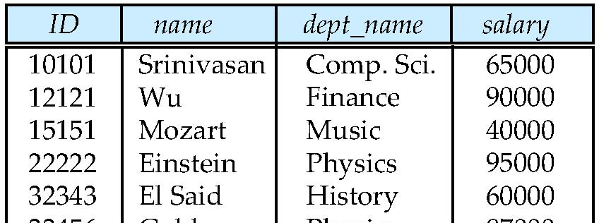
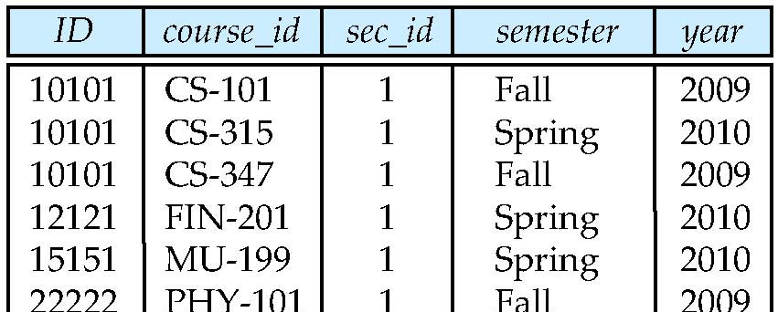
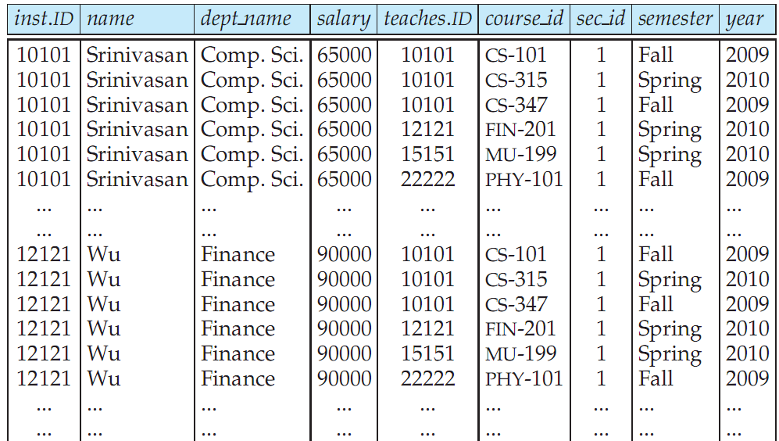
Cartesian Product: instructor X teaches
instructor
teaches

Slide 42
DML: How to Create?
Using Putty
Using MySQL Workbench
Saving SQL Scripts

Slide 43
DML: Inserting Rows with a Subquery
A subquery is a query that is embedded inside another query
Nested query or an inner query
The subquery is executed first:
The output of the inner query is used as input to the outer query
insert into tablename
select columnlist
from tablename
The values returned by columnlist should match the table structure
43

Slide 44
DML: Copying Parts of a Table
Sometimes it is necessary to break a table into smaller tables
Copy parts from the original table to the smaller tables
insert into instructor2(ID, name,salary)
select ID, name, salary
from instructor
where dept_name = ‘History’;
44

Slide 45
Summary
Data Definition language (DDL):
create table
alter table
add column
add primary key
add foreign key
drop column
drop primary key/foreign key
modify column
Data Manipulation Language (DML):
insert
select
update
delete
45

Slide 46
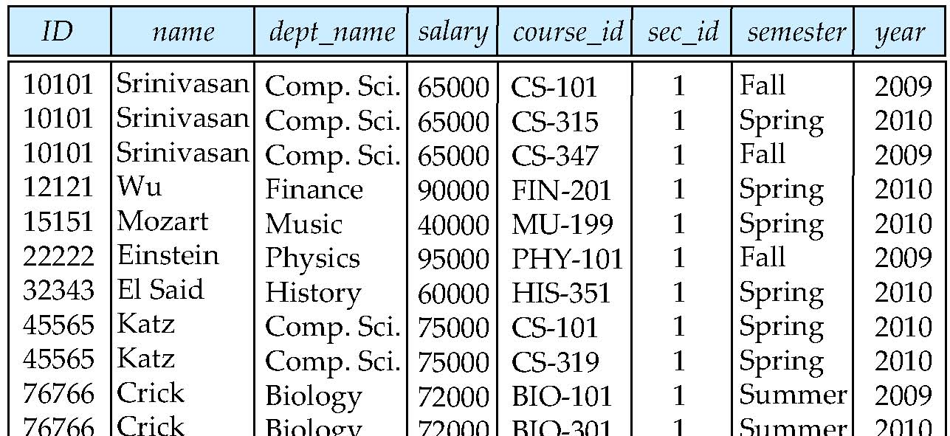
Natural Join
Natural join matches tuples with the same values for all common attributes, and retains only one copy of each common column
select * from instructor natural join teaches;

Slide 47
Natural Join Example
List the names of instructors along with the course ID of the courses that they taught.
select name, course_id from instructor natural join teaches;
select name, course_id from instructor, teaches where instructor.ID = teaches.ID;

Slide 48
Natural Join (contiued)
Danger in natural join: beware of unrelated attributes with same name which get equated incorrectly
List the names of instructors along with the titles of courses that they teach
Incorrect version (makes course.dept_name = instructor.dept_name)
select name, title from instructor natural join teaches natural join course;
Correct version
select name, title from instructor natural join teaches, course where teaches.course_id = course.course_id;

Slide 49
Joins
For all instructors who have taught some course, find their names and the course ID of the courses they taught.
select name, course_id from instructor, teaches where instructor.ID = teaches.ID

Slide 50
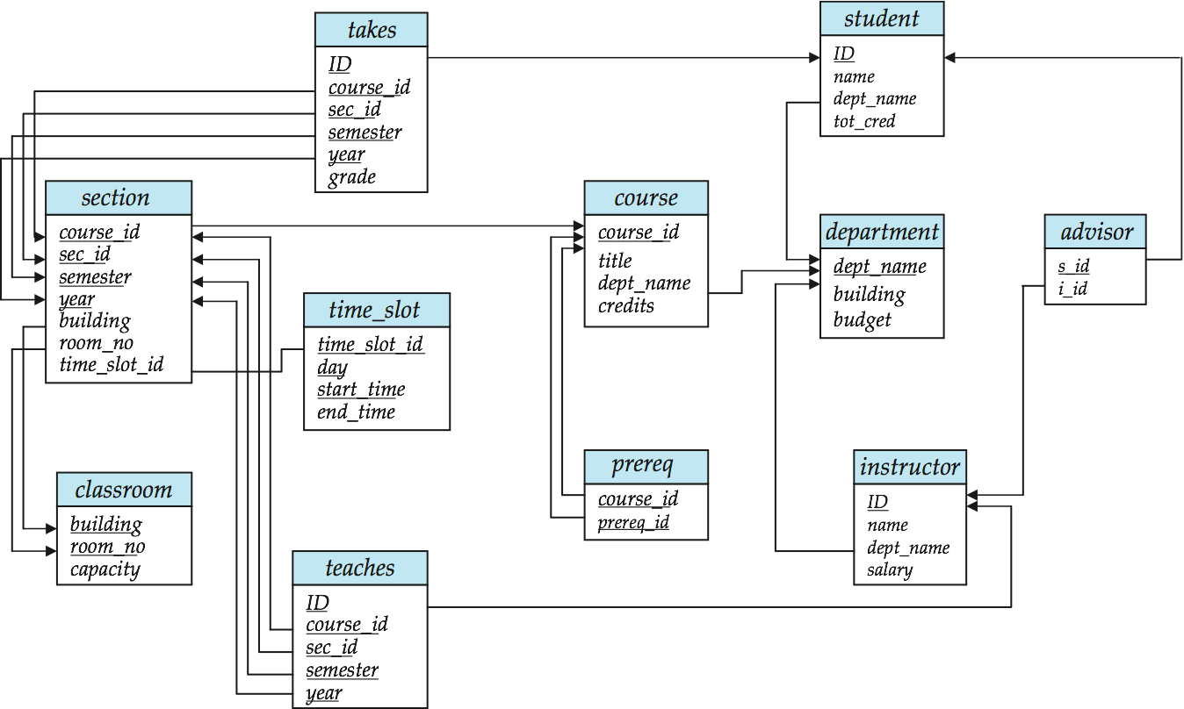
Joins
Find the course ID, semester, year and title of each course offered by the Comp. Sci. department
select section.course_id, semester, year, title from section, course where section.course_id = course.course_id and dept_name = ‘Comp. Sci.’
Why is there a prefix for course_id, highlighted in green?

Slide 51
Schema Diagram for University Database

Slide 52

Class Exercise 3
Find title of courses in ‘Comp. Sci’ department with 3 credits
select title
from course
where dept_name = ‘Comp. Sci’
and credits = 3;

Slide 53

Class Exercise 4
Find the titles of all courses that were taught by an instructor named ‘Einstein’. Make sure there are no duplicates in the result
select distinct course.title
from instructor natural join teaches, course
where teaches.course_id = course.course_id
and instructor.name = 'Brandt’;
OR
select distinct course.title
from instructor i, teaches t, course c
where instructor.ID = teaches.ID
and teaches.course_id = course.course_id
and instructor.name = 'Brandt’;

Slide 54
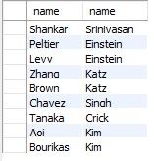
Class Exercise 5
List the name of all students along with the name of student’s advisor.
select student.name, instructor.name
from student, advisor, instructor
where student.ID = advisor.s_id
and advisor.i_id = instructor.ID;
How can you distinguish between two name fields?

Slide 55
Schema Diagram for University Database

Slide 56
department
student
Classroom
course
instructor
prereq
time_slot
advisor
section
takes
teaches

Slide 57
Reading and Assignment

